Slide 1


HACK THE BOX AUDIT PROJECT WORKFLOW
PRESENTED BY
ANUJ KULAT
SYED HUSSAIN
Detailed Steps and Techniques for Successful Exploitation
Notes:
Today, we’ll take you step-by-step through the process of auditing and exploiting a target machine in a structured and ethical manner.
Before we dive in, let me explain what Hack The Box is. Hack The Box, or HTB, is an online platform designed for cybersecurity enthusiasts and professionals. It provides virtual machines simulating real-world vulnerabilities, offering a safe space for penetration testing and skill-building.

Slide 2


EXECUTION
1
Initial Setup
2
Connect to Hack The Box VPN
3
Perform an Initial Nmap Scan
4
Download and Analyze APK Files
5
Inspect and Extract Java Code
6
Configure Hosts File
7
Explore the Swagger API
8
Exploit Vulnerabilities
9
Post-Exploitation
10
Accessing Admin Panel
11
getting user access
Notes:
Our audit process is divided into 14 clear steps, beginning with environment setup and progressing through reconnaissance, exploitation, post-exploitation, and privilege escalation. Each step builds upon the previous one, ensuring a systematic approach to identifying and leveraging vulnerabilities. Let’s begin with the first step: setting up our environment.”

Slide 3

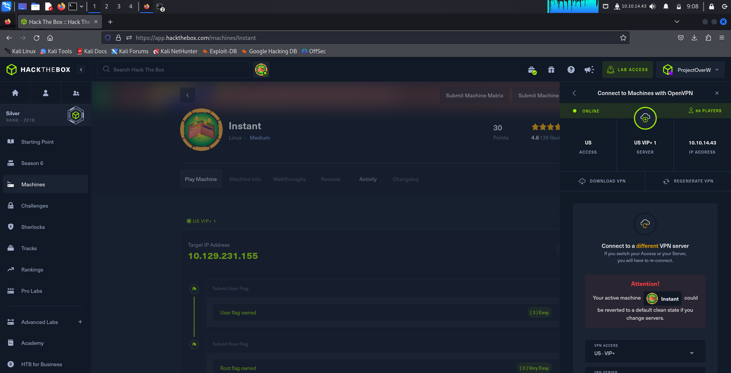
STEP 1
• Ensure your environment is ready with the following tools:
-Kali Linux
-Hack The Box account
-Visual Studio Code
•Install dependencies:
-sudo apt update
-sudo apt install python3 pip apktool
Notes:
The first step is preparing our environment. For this, we used Kali Linux, Visual Studio Code, and an active Hack The Box account. These tools are essential for interacting with the target machine and analyzing its vulnerabilities.

Slide 4
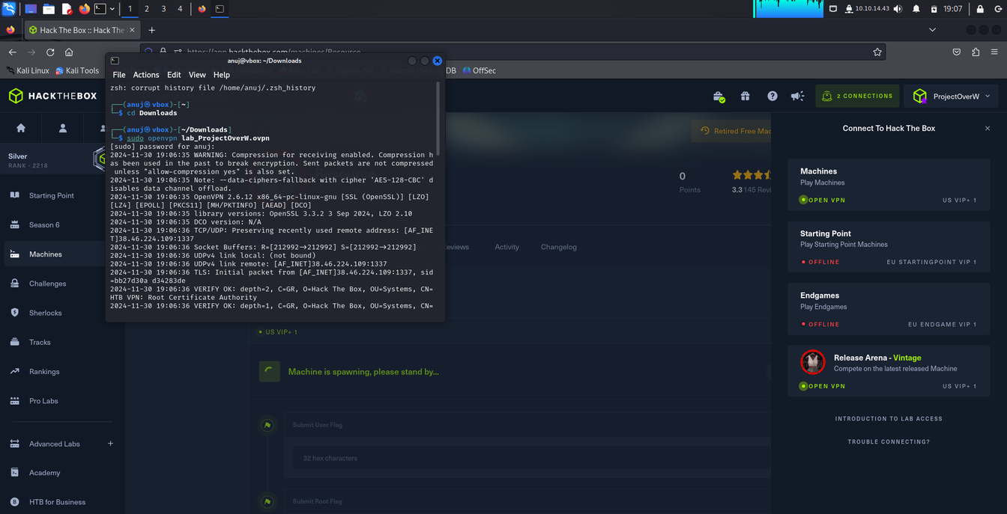
STEP 2
Navigate to the VPN section on Hack The Box and download your VPN configuration file.
Start the VPN connection:
-sudo openvpn<your_vpn_file.ovpn>
Verify your connection:
-ifconfig (Ensure you see a tun0 interface).
Notes:
The next step is establishing a connection to Hack The Box’s secure network. To access their machines, we use OpenVPN, a tunneling protocol that creates a secure virtual network.
We then verified the connection with ifconfig to ensure the tun0 interface was active. OpenVPN is crucial because it lets us safely interact with the target machine as though it’s on our local network, without exposing sensitive data. Think of it as creating a secure bridge to Hack The Box.”

Slide 5
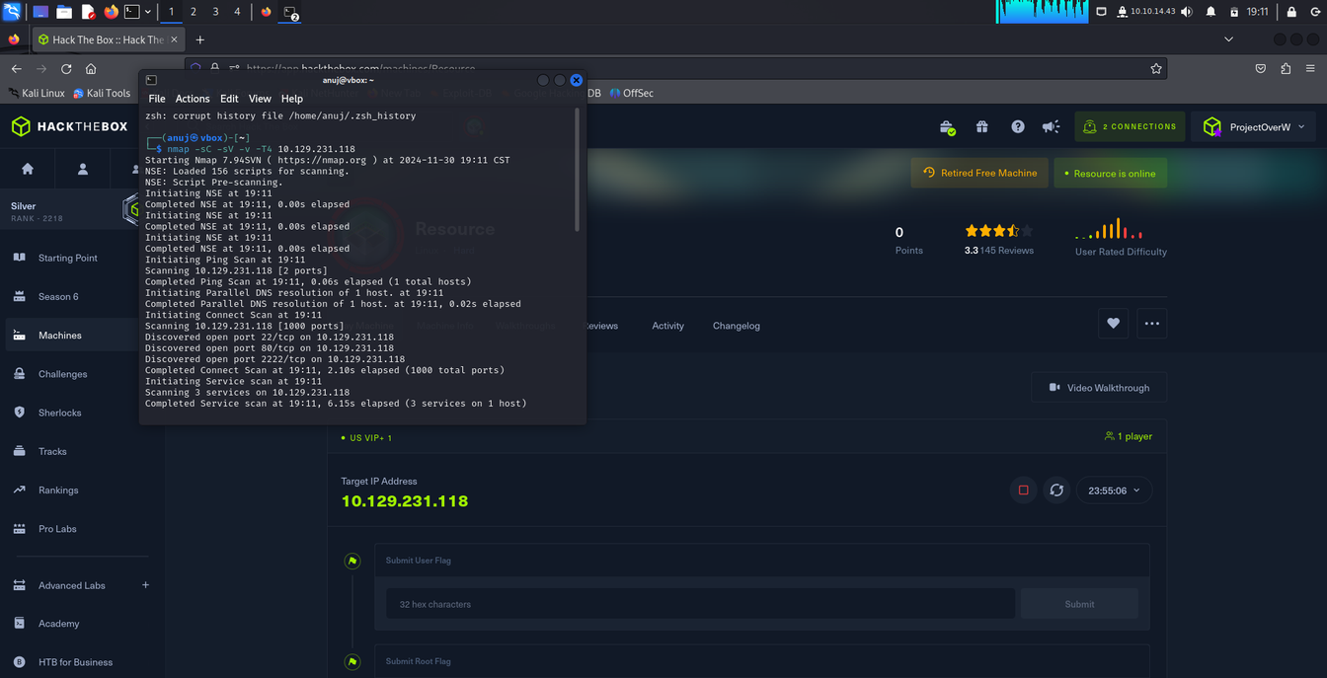
STEP 3 ( RECONNAISSANCE)
Open a terminal and run an Nmap scan to identify open ports and services:
-nmap -sC -sV -v -T4 <target_IP>
Review the output to find services and ports.
Notes:
Using Nmap, we identify open ports, running services, and their versions. This helps us understand the machine’s structure and pinpoint potential vulnerabilities.
-sC -- runs default scripts to gather basic information.
-sV -- detects the versions of running services.
-v -- adds verbosity for detailed output.
-T4 -- speeds up the scan.

Slide 6
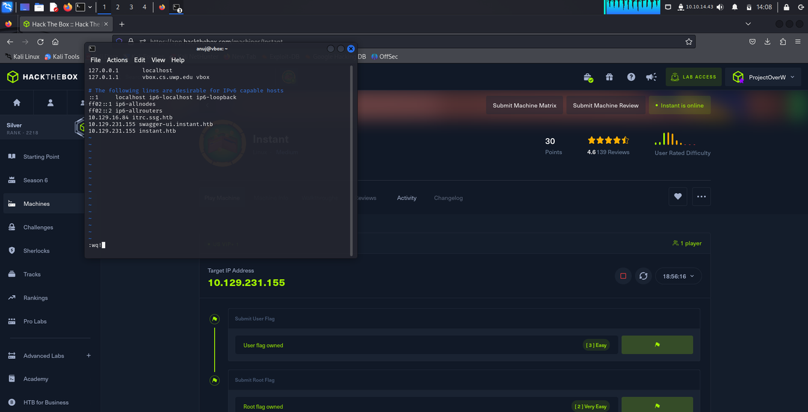
STEP
Edit the hosts file:
-sudo nano /etc/hosts
Add the following lines:
-10.129.231.155 instant.htb
Notes:
where we dig deeper into the system. In this case, the target provided an APK file. APK files are Android application packages, which can often contain sensitive information if not secured properly.

Slide 7
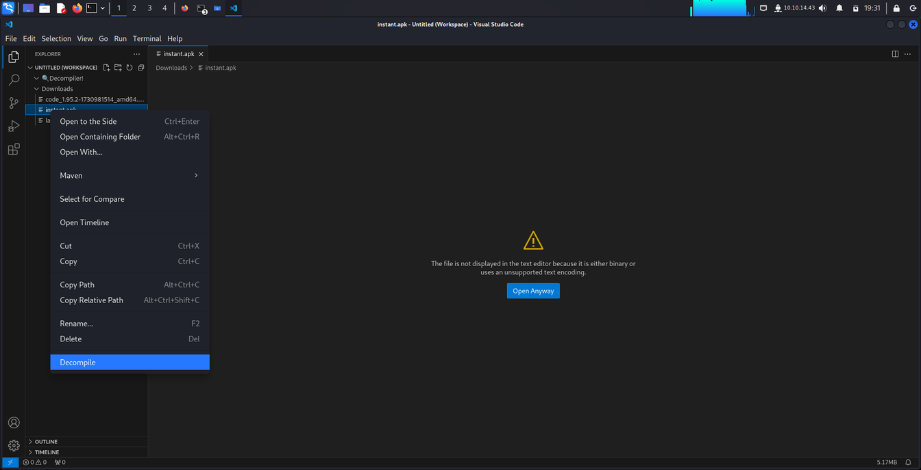
STEP 4 ( ENUMERATION)
Download the APK file provided by the target.
Decompile the APK using apktool:
-apktool d <filename>.apk
after enumerating the apk files we founded the AdminAcitivies.java and in the xml part we founded the securityconfig.xml which lead to our foothold
Notes:
To simplify our workflow, we edited the hosts file on our system to map the target machine’s IP address to domain names
This allowed us to access the machine using domain names rather than IP addresses, streamlining our interactions.”

Slide 8
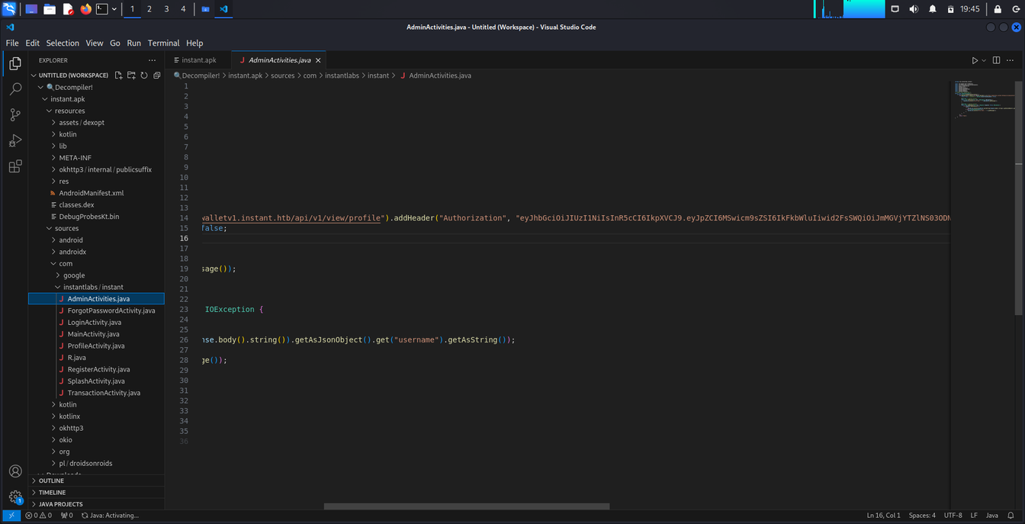
STEP 5
Open the decompiled folder in Visual Studio Code.
Look for sensitive information like API endpoints or tokens in files like AdminActivities.java
The file shows that jsw token was hardcoded in the apk file and the hacker can take the advantage for it to get some kind of authrization
Notes:
With the JWT token in hand, we accessed the Swagger API at:
Swagger APIs are designed for developers to interact with backend systems, but in this case, we used it to test endpoints and gain an initial foothold in the system. By leveraging the hardcoded token, we bypassed authentication, securing our first level of access to the machine.”

Slide 9
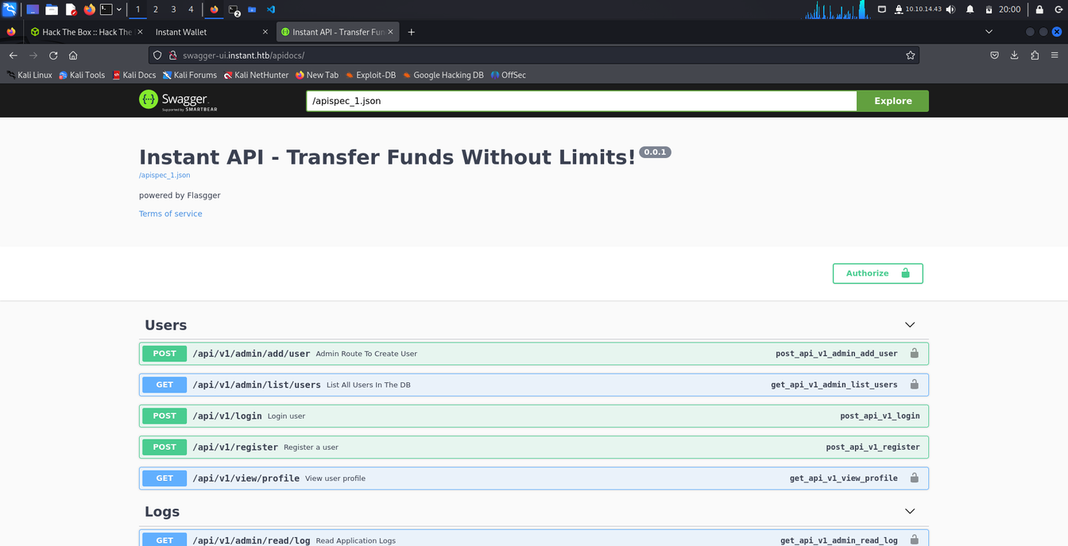
STEP 6 (FOOTHOLD )
Open your browser and go to http://swagger-ui.instant.htb.
Use available endpoints to test API functionality.
we can use that hard coded jsw token for getting the initial access
Notes:
,we discovered a Local File Inclusion (LFI) vulnerability using payloads like:
../../etc/passwd
This allowed us to access sensitive files, including private SSH keys. But why are SSH keys important?
SSH, or Secure Shell, is a protocol used to securely connect to remote machines. With private keys, we could authenticate as a legitimate user, gaining deeper access to the system.”

Slide 10
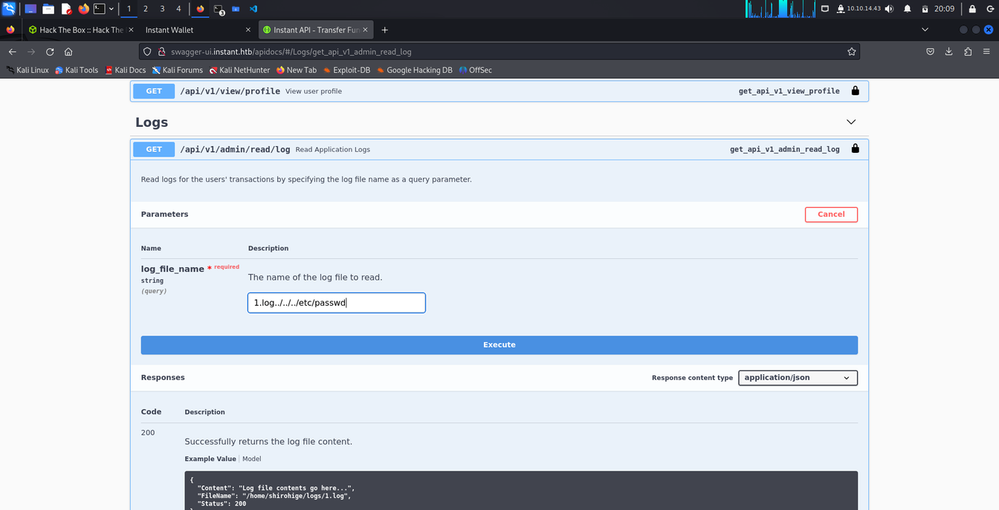
STEP 8 (EXPLOIT)
Test for vulnerabilities:
-Directory Traversal:../../etc/passwd
This expose the Local File inclusion Vulnerablity where we are able to include the local file from the server . We can also access private ssh key via LFI attack to get the user access to the box.
Notes:
Once we had SSH access, we explored the machine further. We discovered a database file named instant.db, which contained hashed passwords. Using SQLite3, we queried the database to extract the hashes.
Unfortunately, standard tools like John the Ripper couldn’t crack the hashes, so we used a GitHub tool called Werkzeug Cracker to decrypt them. This adaptability highlights the importance of choosing the right tools for the situation.”

Slide 11
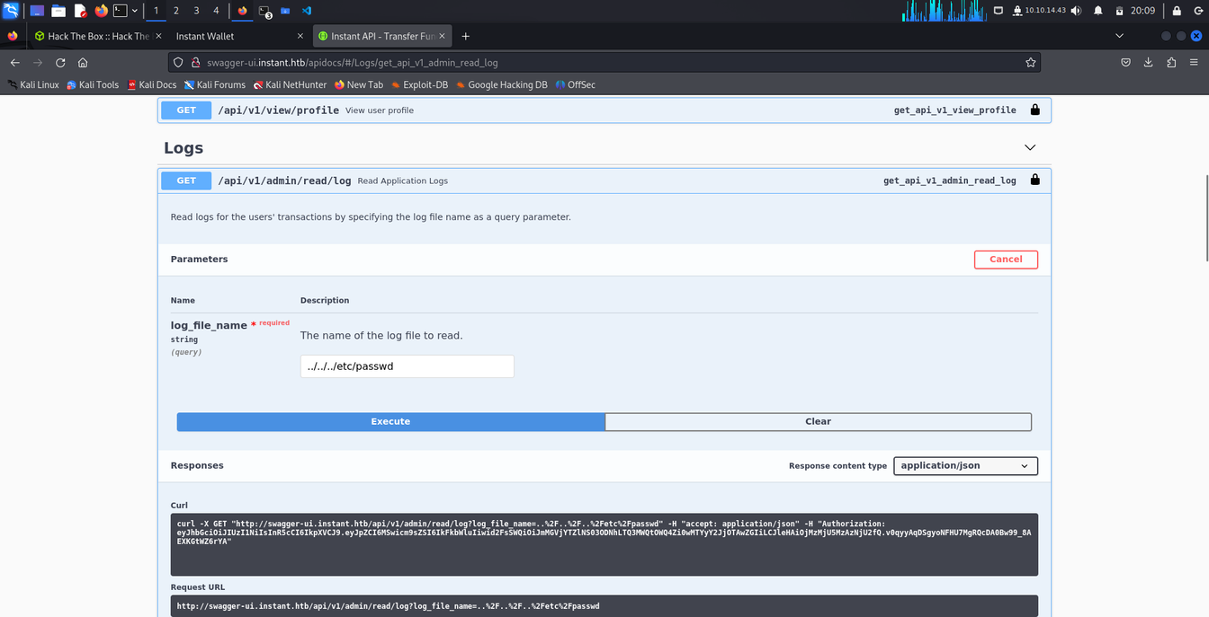
STEP 9
Extract sensitive data using successful exploitation.
Example: Extract /etc/passwd using API requests.
Save retrieved data locally for analysis.

Slide 12
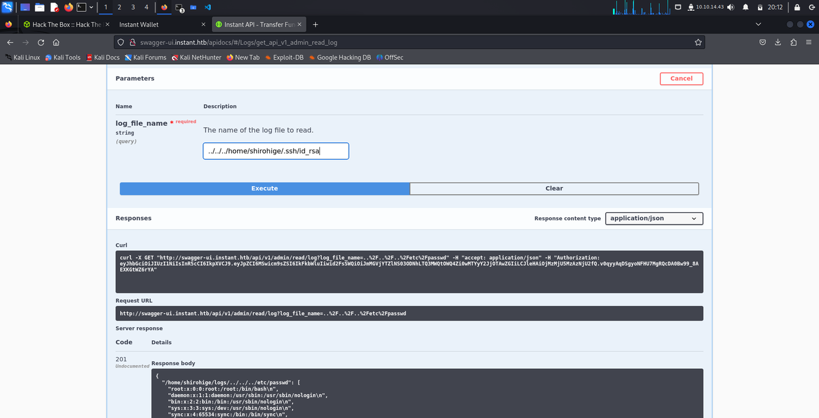
STEP 10 (GRABBING PRIVATE SSH KEYS VIA LFI)
private ssh keys were extracted via local file inclusion attack and hacker is able to get the access to the linux machine.

Slide 13
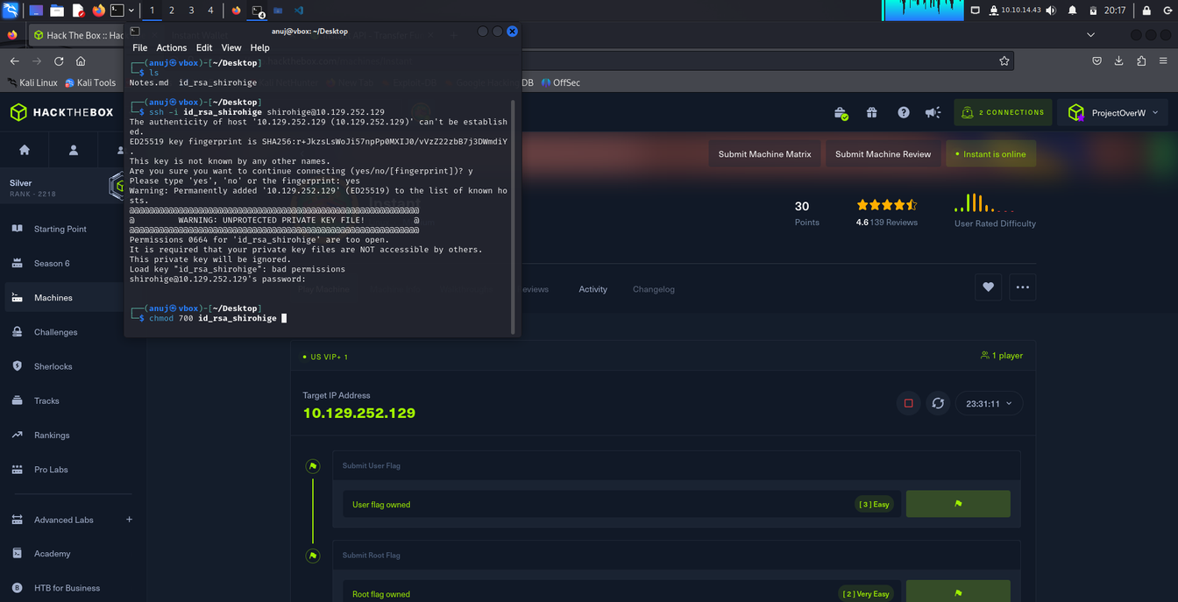
STEP 11( POST EXPLOIT)
To connect to the target box via ssh private keys
ssh -i file_name user@ip

Slide 14
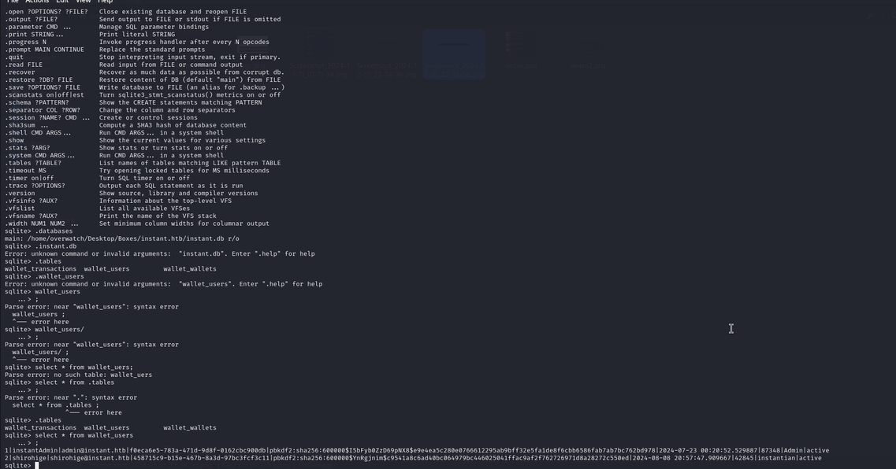
STEP 12( PRIVILAGE ESCALATION)
after accessing the user we discover a filed called instant.db
after opening it via sqlite3 founded tables
after quering the tables we the user password in the hash form

Slide 15
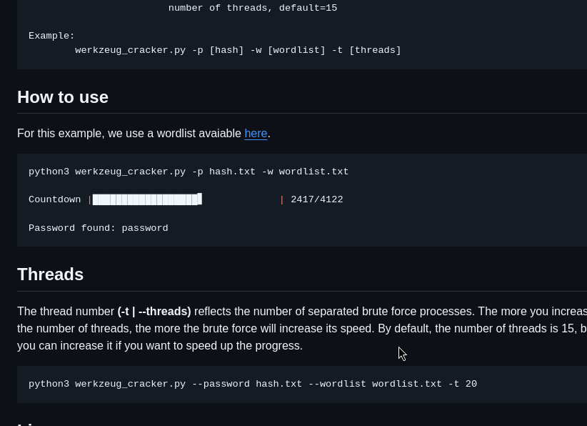
STEP 13( CRACKING THE HASHES)
problem with the hashes is that they were old or the kali linux famous tool jhon the ripper or hash crack were unable to crack it.
Had to find the other way around
we use the werkzueg hash crack to crack the hash found from the instant.db fine
using the github link https://github.com/AnataarXVI/Werkzeug-Cracker

Slide 16
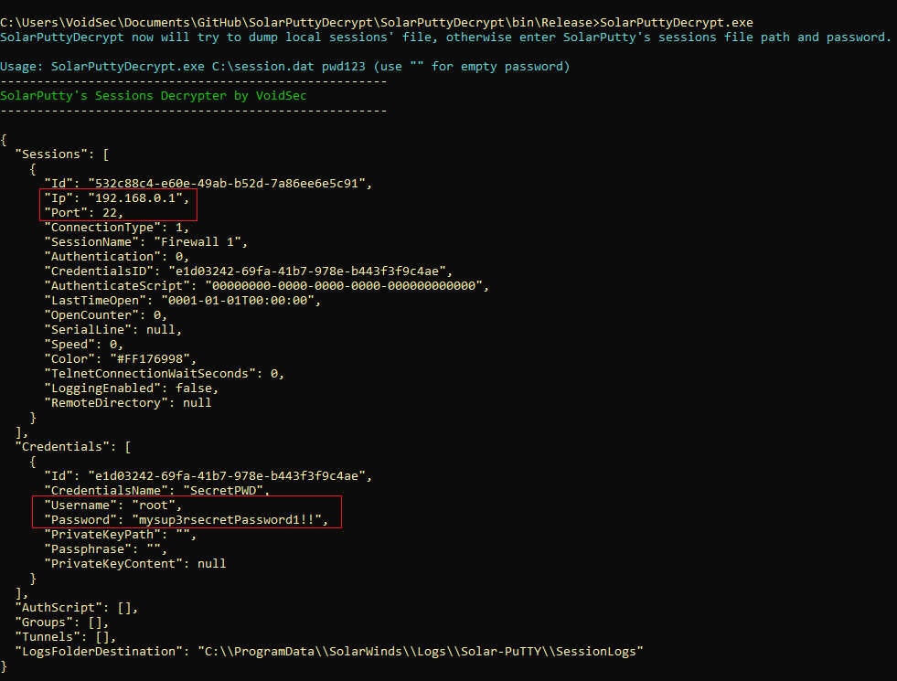
STEP 14( FINDING THE ROOT)
upon enumerating the target linux machine we were able to found a backup directory called solar-putty
There was a old exploit for it found on the github as well Solar-putty Decrypt
we followed the command as per github link https://github.com/VoidSec/SolarPuttyDecrypt
we were able to get the root password we well

Slide 17

ANY
QUESTIONS?

Slide 18
Thank you for listening

